Slide 1
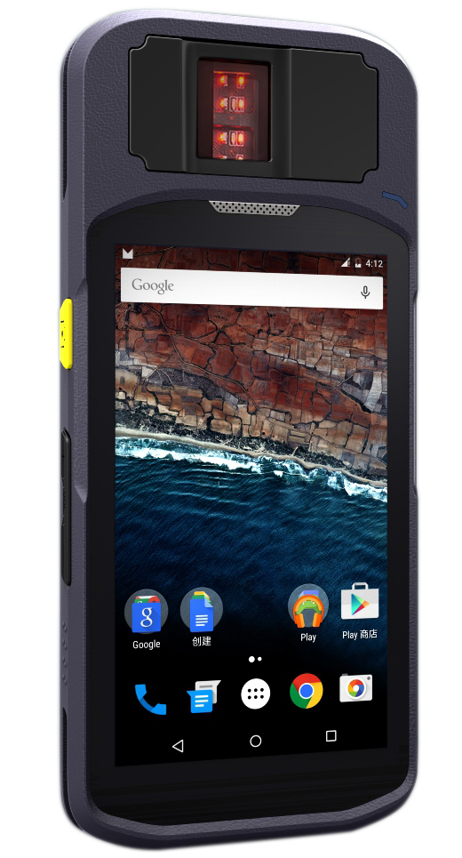





Biometric Smart Terminal H5
Compact and all-round handheld terminal build for
versatile biometric application needs.
Highly Integrated with multiple biometric and identity features, the H5 brings a state of the art capability for biometric enrollment, verification, and identification. The H5’s CPU card reading support, iris scanner and world
wide network support compatibility enables diversified application ability.
Product Feature
Modern and Rugged Design with light weight.
64 bit Quad Core fast processing CPU.
FBI certified Suprema Fingerprint Scanner, FAP20 500DPI, Live Detection,
Iris scanner available
Multiple communication method: GPRS, 3G, 4G LTE, WIFI, bluetooth.
Built-in NXP NFC/RFID contactless card reader,ISO14443A/B,ISO15693,ISO18092
Built-in contact card reader supporting CPU card reading.
5,000mAh Large Volume Li-on battery
PSAM Card support
Barcode Scanning Supported via Camera
Applications
Biometric Registration
Voter Verification
National Identity Application
E-KYC
Law Enforcement
Border control
Time Attendance
Access Control

Slide 2
Specification
Item | Specification
Operation System | Android 5.1 Lollipop or 8.1 Oreo
CPU | ARM Cortex A53 Quad Core 1.3~1.45Ghz
Memory | RAM 1GB/2GB ROM FLASH 8GB/16GB
Screen | 5” 854x480 pixels Capacitive Touch Screen 5” 1280x720 pixels IPS Capacitive Touch Screen(Optional)
Communication | Wi-Fi: 802.11 a/b/g/n 2G: GSM/GPRS/EDGE 3G: WCDMA HSPA UMTS 850/900/1700/1900/2100Mhz 4G: FDD-LTE B1 B3 B7 B8 B28, TDD-LTE B38 B39 B40 B41B Bluetooth: 4.0
HD Camera | 8 Mega Pixels with Flash light, Auto Focus (Rear Camera) 13 Mega Pixels Sony Camera Sensor with Flash light, Auto Focus (Optional, Rear Camera)
GPS(Optional) | GPS/AGPS
Fingerprint Scanner | Suprema BioSlim 2, Optical, 500DPI, with Live Detection Technology, Templates Compliant with ISO19794-2, ANSI-378, FBI Certified, FAP20
Iris Scanner(Optional) | Sony Image Sensor, Osram Infrared LED, Image Format, ISO19794-6
Smart Card Reader(Optional) | ISO7816, CPU card reading supported
RFID Reader(Optional) | NXP Module, 13.56MHZ, ISO14443 Type A/B, Mifare, Contactless CPU Card, E Passport Reading Supported, NFC Supported etc
SAM(Optional) | 1xSAM Card Slot, ISO 7816–compliant (Class A)
SIM slots | 2x micro SIMs
SD card | Micro SD, maximum=32GB
Interface | USB, DC for charging
Battery | 5,000mAh Li-ion Rechargeable Battery
Power Supply Charging | D/C 5V, 2A Power Supply 5V, High current charging 2A(Texas Instruments Charging IC)
Accessories(Optional) | Hand strip
Dimension | 182x81x25mm

